Slide 1
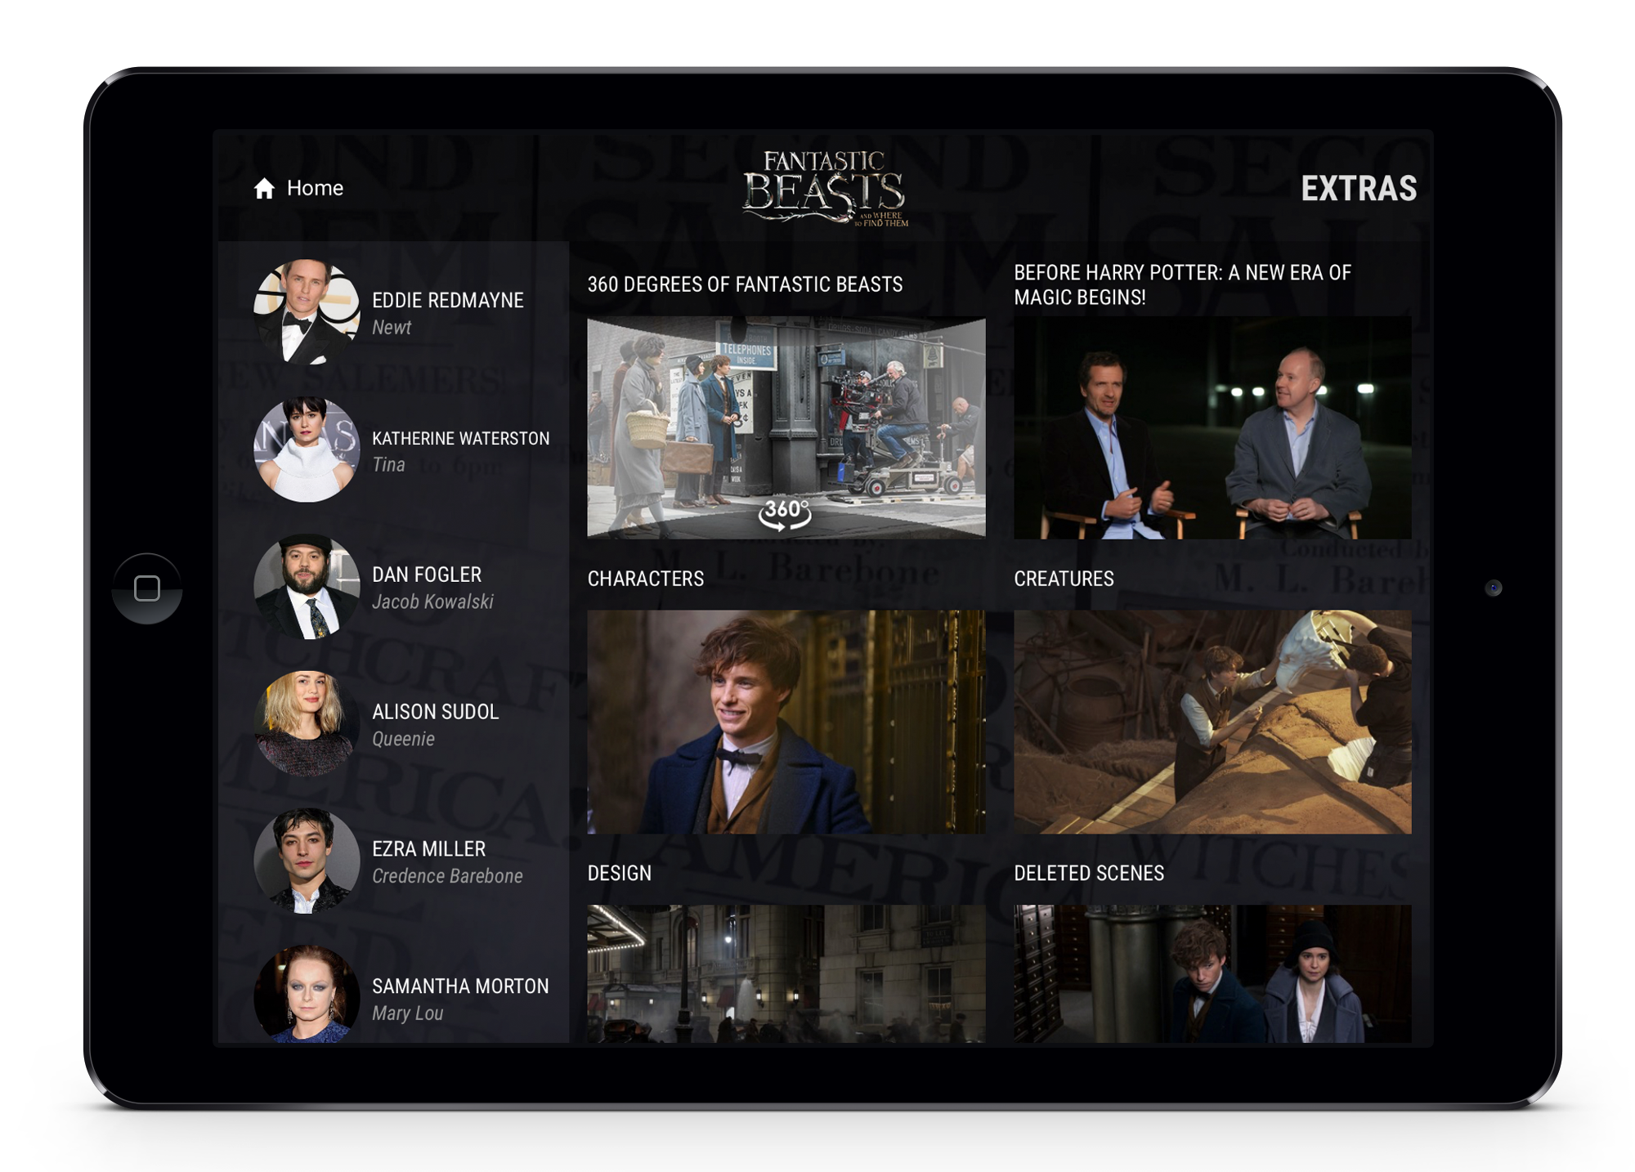
CPE Experience Open Source Library
https://github.com/warnerbros
Warner Bros. Entertainment, Inc.
Alec Ananian
Grant Cheng
Imran Saadi

Slide 2
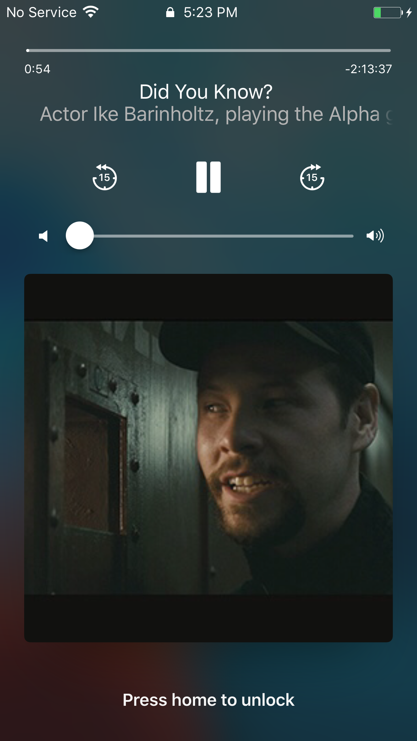
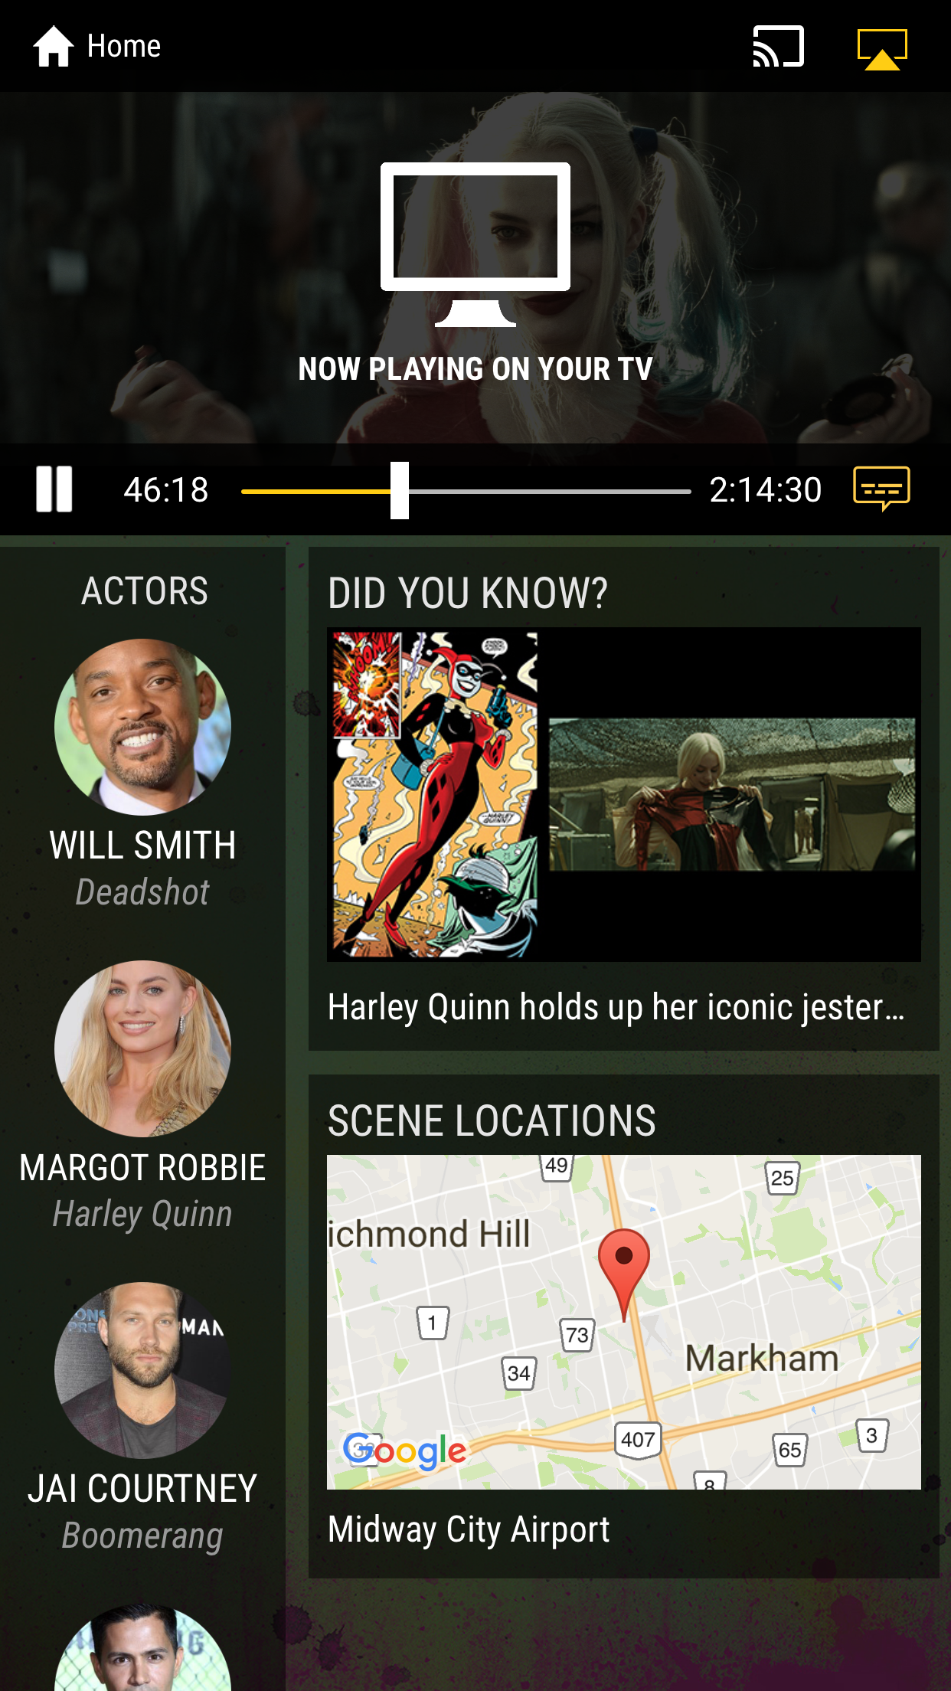
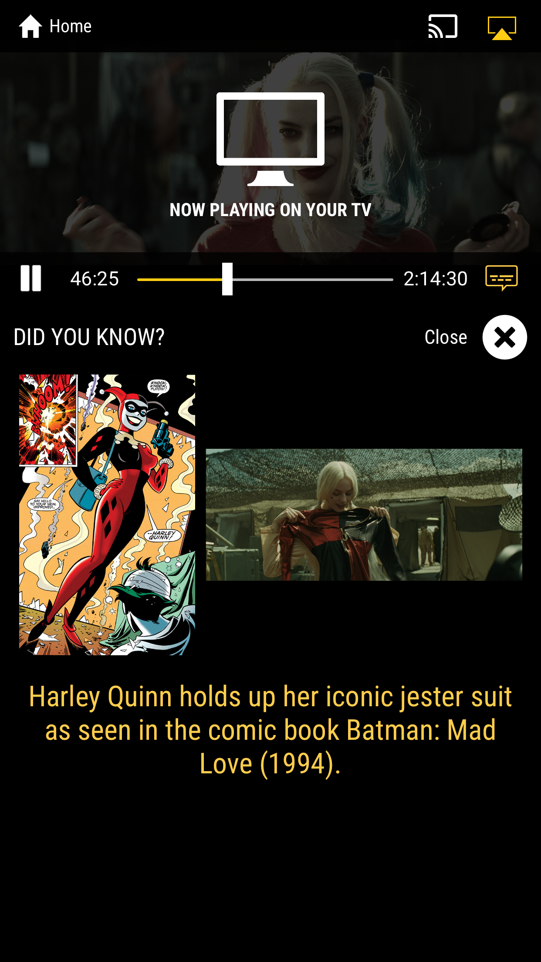
Technical Features
Feature-rich video player
Second screen experience
Google Cast via Chromecast
Apple TV support via AirPlay
iPad Picture-in-Picture
Command Center Controls
WebVTT caption support
Director commentary track toggle
User interaction callbacks
Connection status and experience lifecycle management
Granular analytics events
Integration with DRM Solutions
iOS: FairPlay streaming
Android: MPEG-DASH w/ Widevine DRM
Chromecast: Smooth Streaming or MPEG-DASH w/ Widevine DRM
Flexibility to implement custom DRM solutions

Slide 3

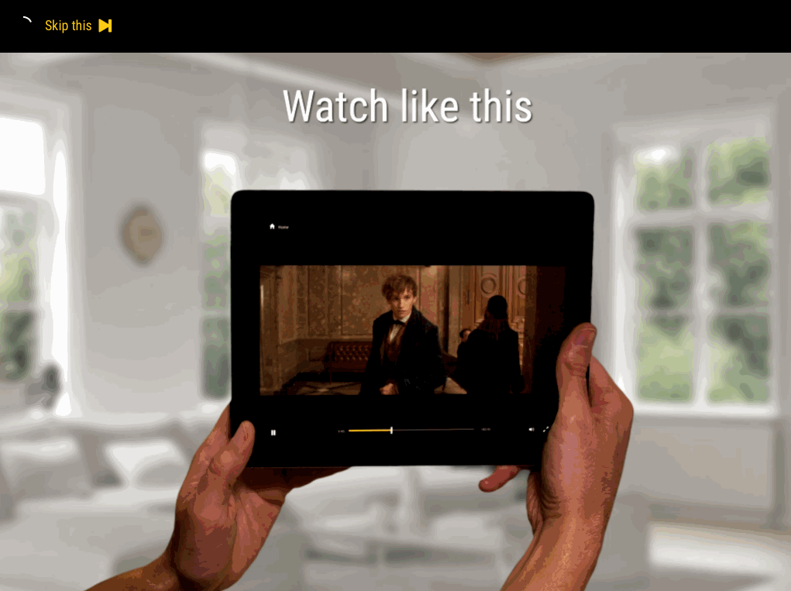
Best Practices
Looping intro video
Stylized “Play” and “Extras” buttons
How-to video guide that plays before the feature (i.e. interstitial)

Slide 4
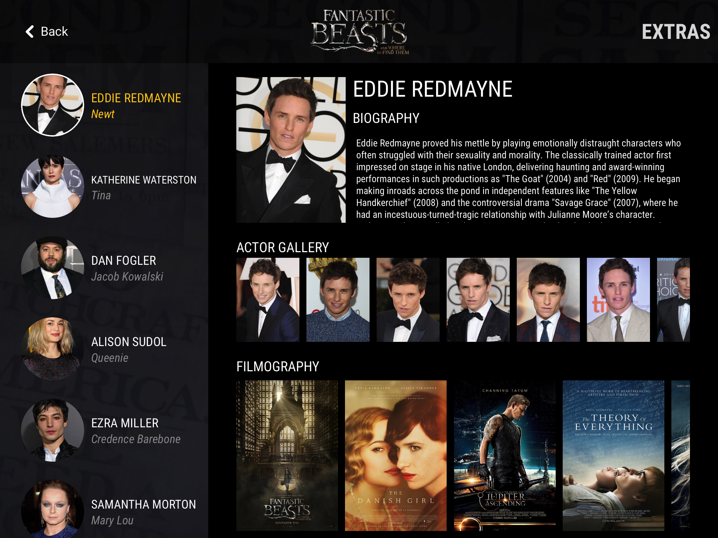
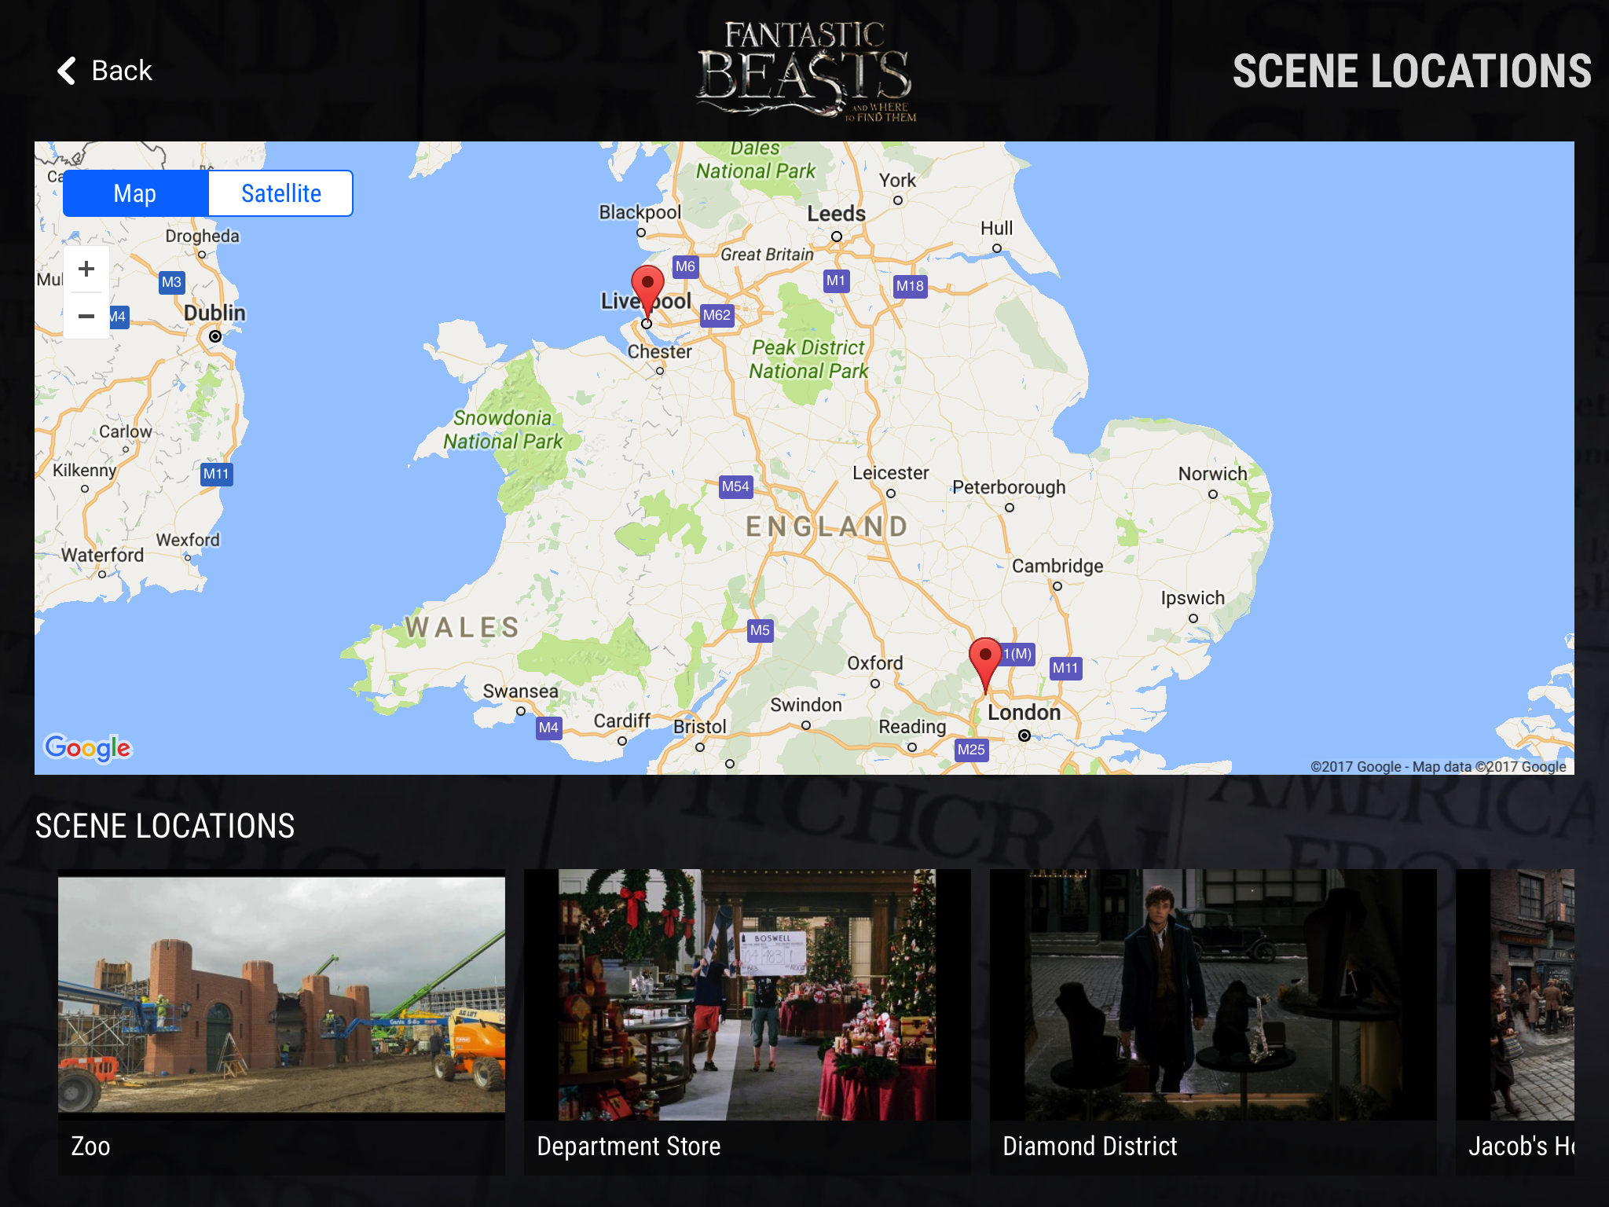
Best Practices
Gracenote API license for talent details
Google Maps API license for interactive maps

Slide 5
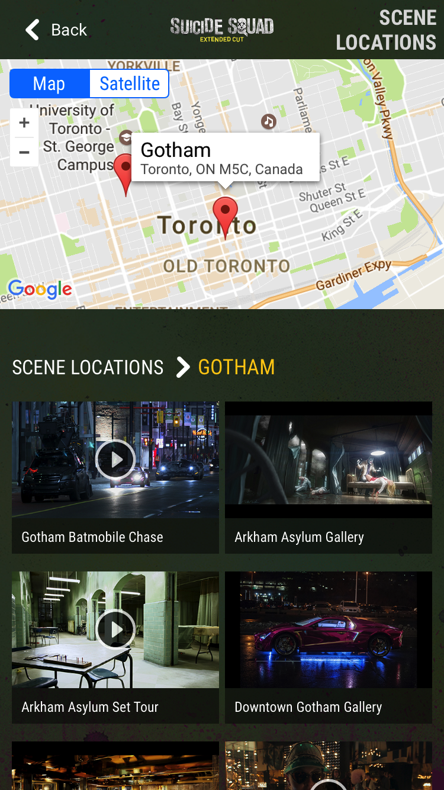
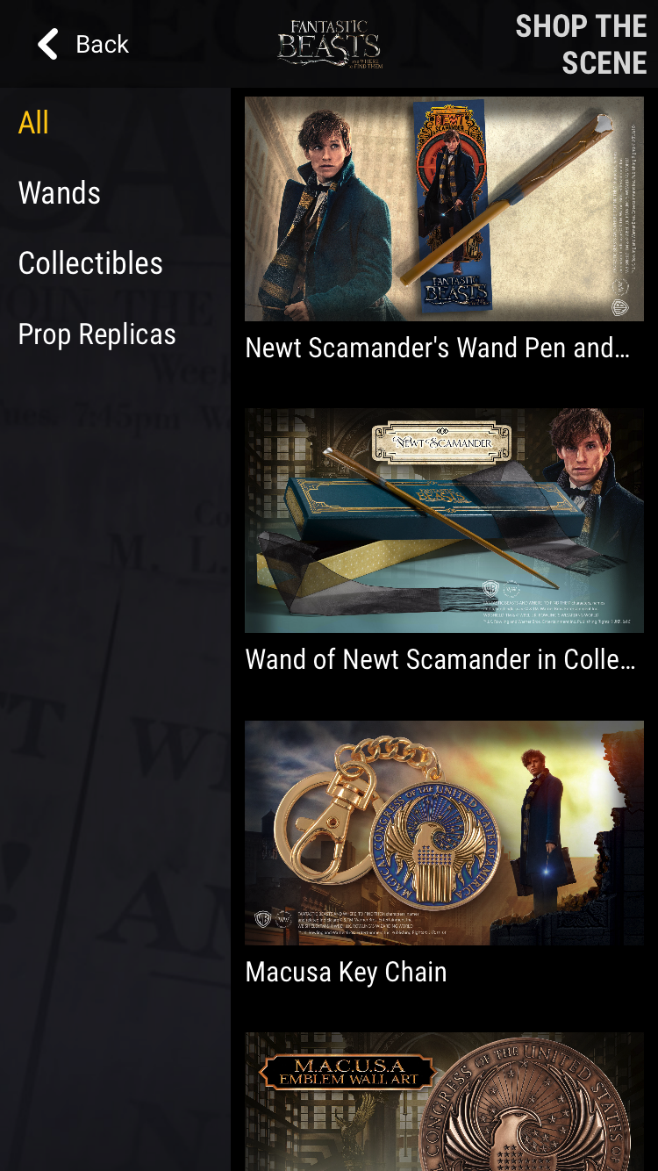
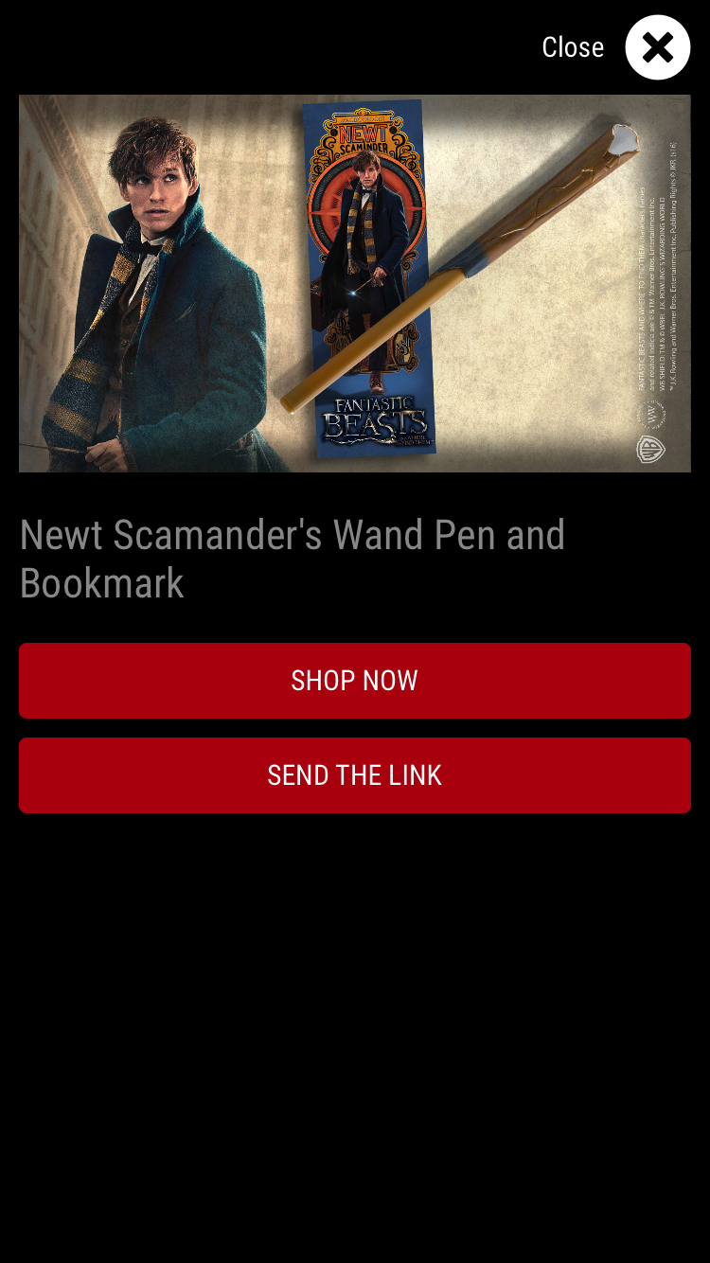
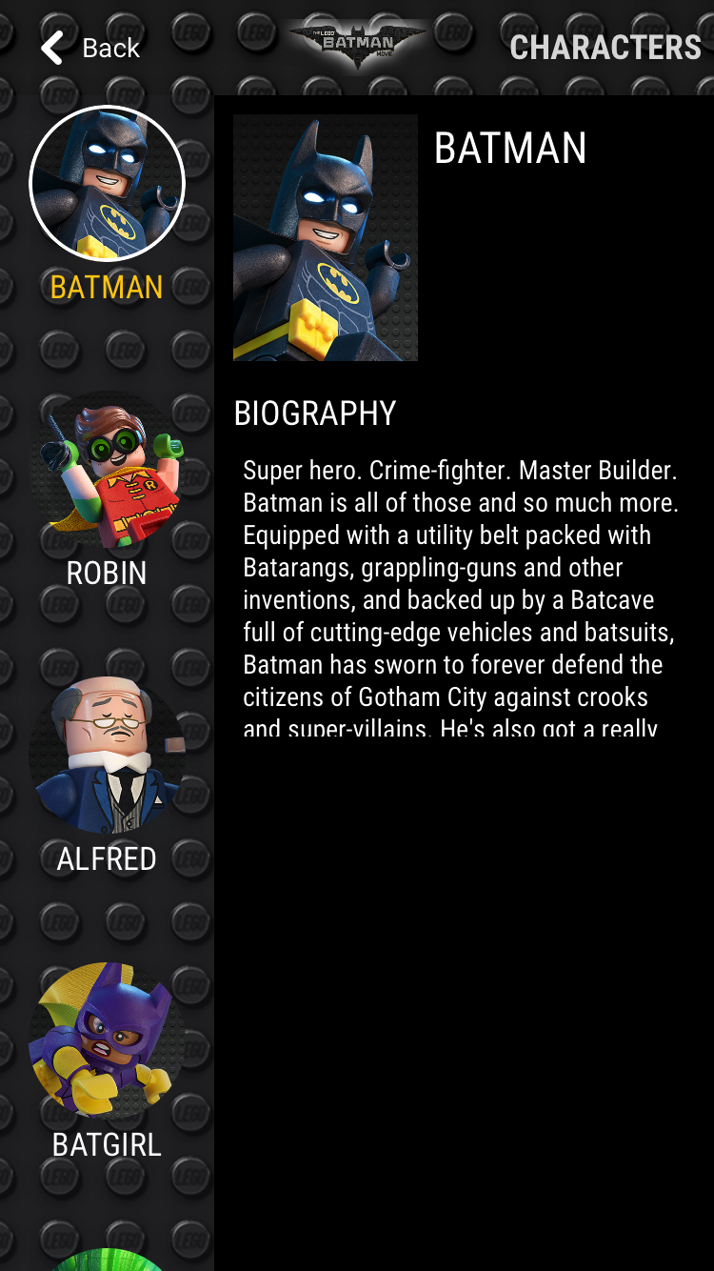
CPE-AppData
Spec is being used to extend the Media Manifest’s scope and provide the data powering interactive experiences:
Scene Locations
Shopping
Characters

Slide 6
CPE-AppData
XML data is kept to the bare minimum and Media Manifest spec elements are reused wherever possible:
<md:People>
<md:Job>
<md:BillingBlockOrder>1</md:BillingBlockOrder>
</md:Job>
<md:Name>
<md:SortName>Batman</md:SortName>
</md:Name>
<md:Identifier>
<md:Identifier>md:appid:people.01</md:Identifier>
<md:Namespace>AppID</md:Namespace>
</md:Identifier>
</md:People>
<manifestdata:ManifestAppData AppID="md:appid:people.01">
<manifestdata:NVPair Name="type">
<manifestdata:Text>PERSON</manifestdata:Text>
</manifestdata:NVPair>
<manifestdata:NVPair Name="description">
<manifestdata:Text>Super hero. Crime-fighter. Master Builder. Batman is all of those and more.</manifestdata:Text>
</manifestdata:NVPair>
<manifestdata:NVPair Name="picture_id">
<manifestdata:PictureID>md:pictureid:people.01</manifestdata:PictureID>
</manifestdata:NVPair>
</manifestdata:ManifestAppData>
Full documentation for studio adoption available at https://warnerbros.github.io

Slide 7
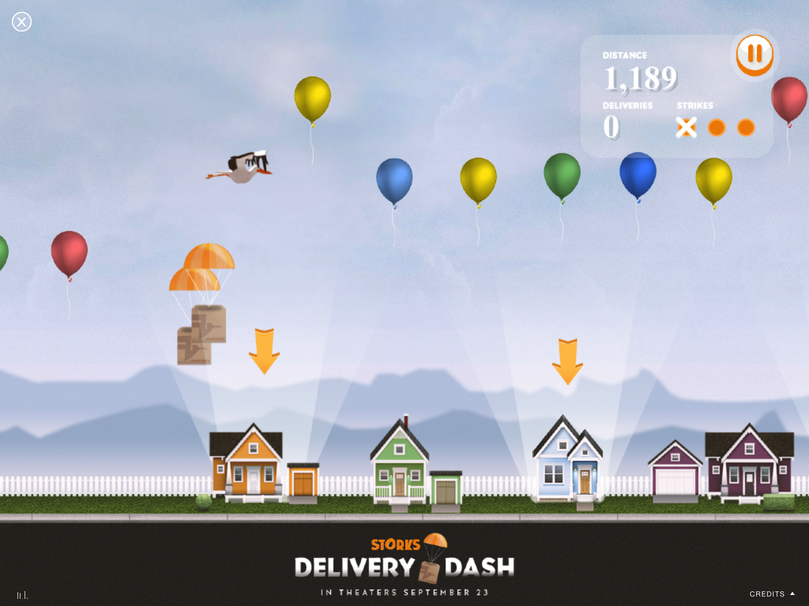
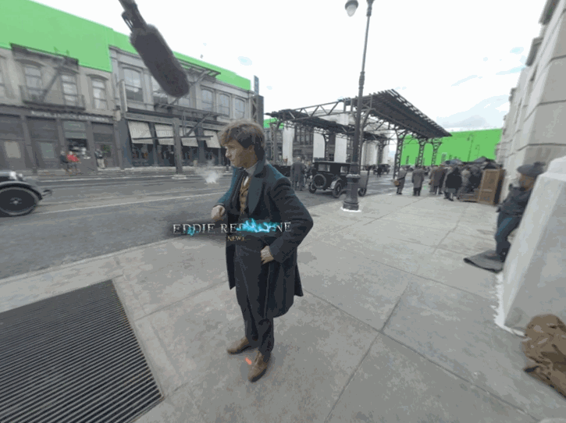
MicroHTML
Rich experiences that would either take considerable effort to port to native mobile code or that should be reused from over-the-top experiences can be reworked for mobile touch support with HTML and launched in web views:
Games
360º Video

Slide 8
Pain Points & Challenges
MicroHTML
Rework experiences from remote controls to mobile touch
Performance & Flexibility
Optimize turntable galleries, 360º videos and VR experiences for wide array of devices and hardware capabilities (particularly on Android)
Keep file size down to not bloat retailer application, sometimes at the expense of integrating third-party SDKs
Retailer Adoption
Make it easier for retailers to initially integrate open source code and take in future updates on a regular basis
Accommodate applications with custom video players and DRM solutions

Slide 9
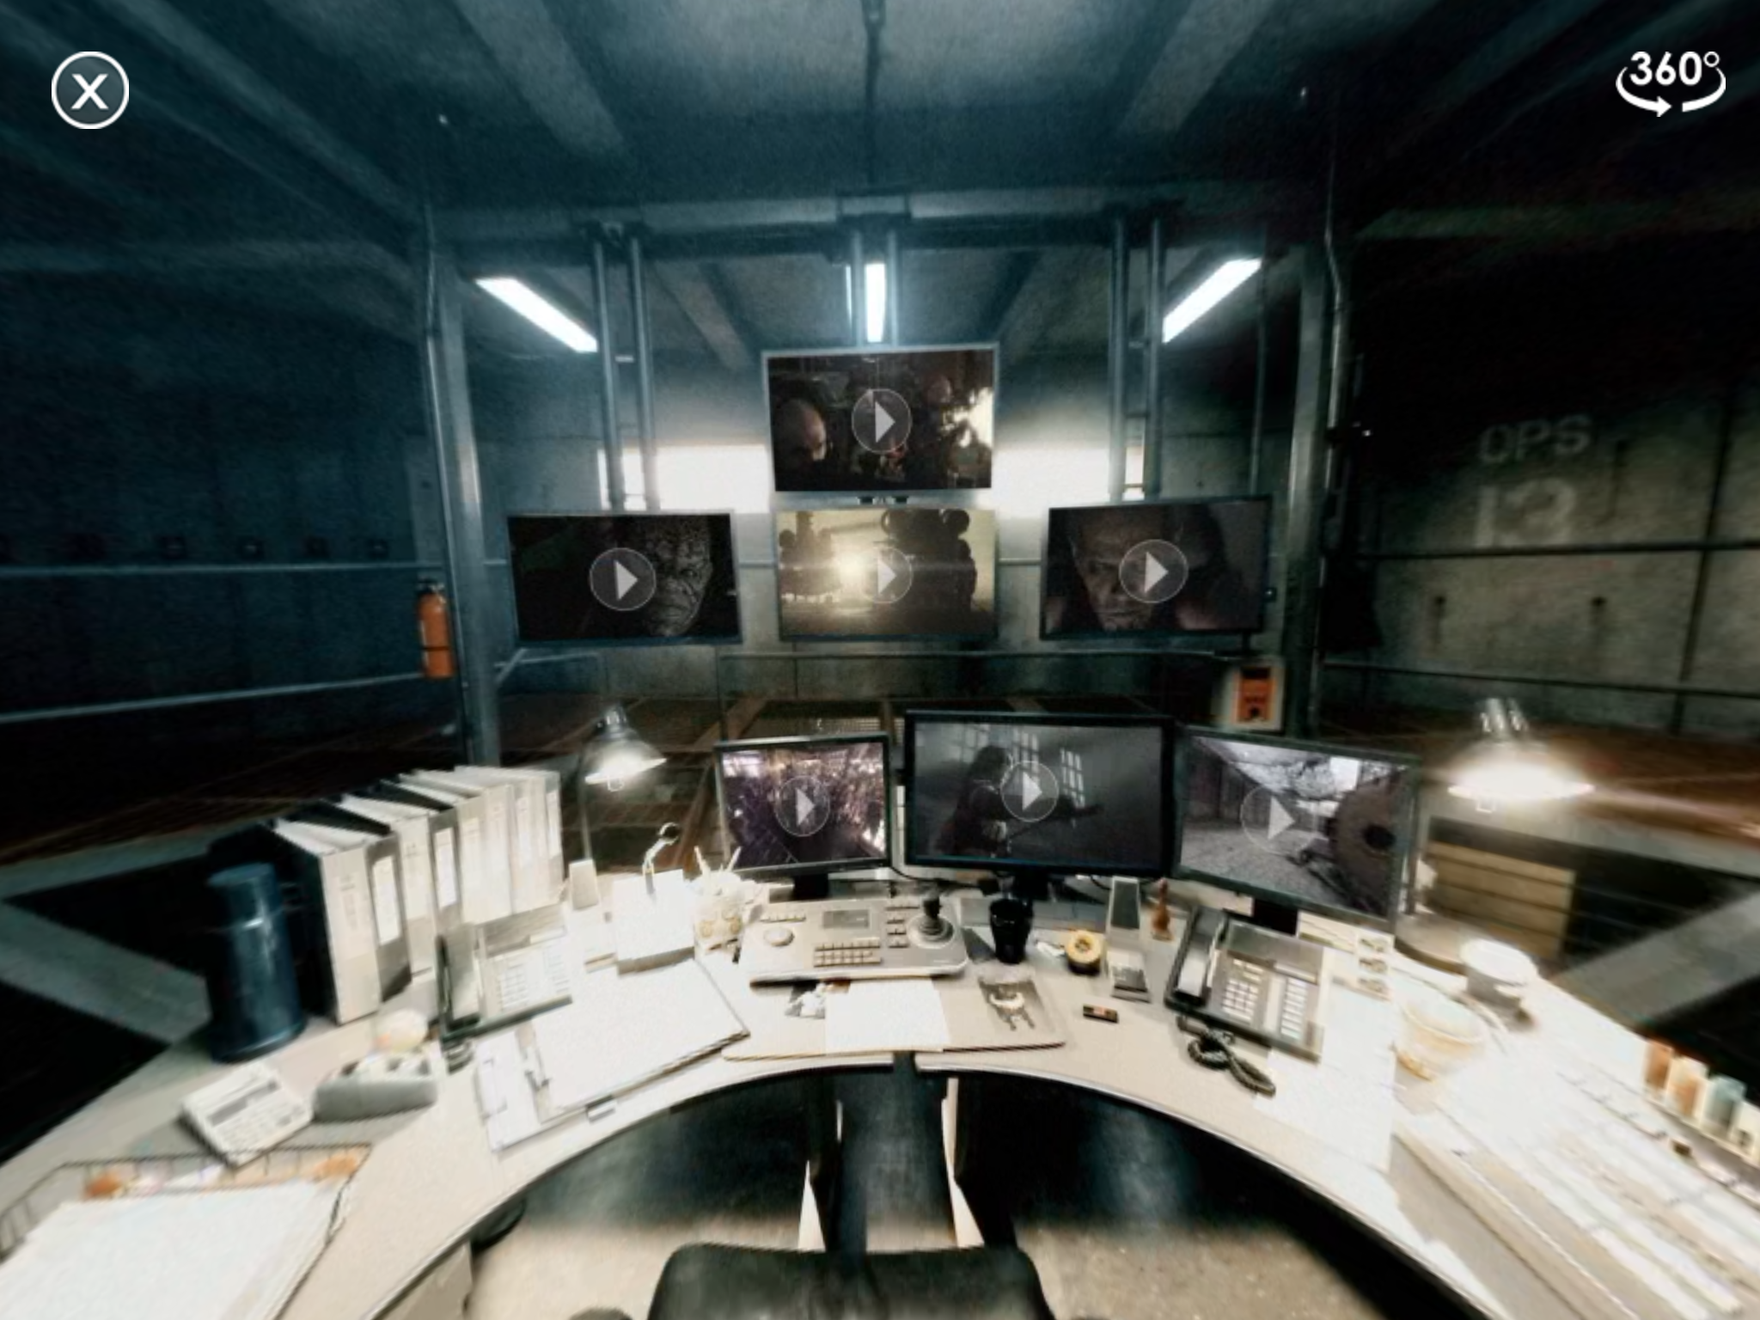
Solutions: MicroHTML
Integrates with the mobile application to send notifications about the lifecycle of the HTML app (loading, loaded, ready to shut down, etc.)
Can be expanded to support more aspects of CPE-HTML spec
Close button sends “shut down” message

Slide 10
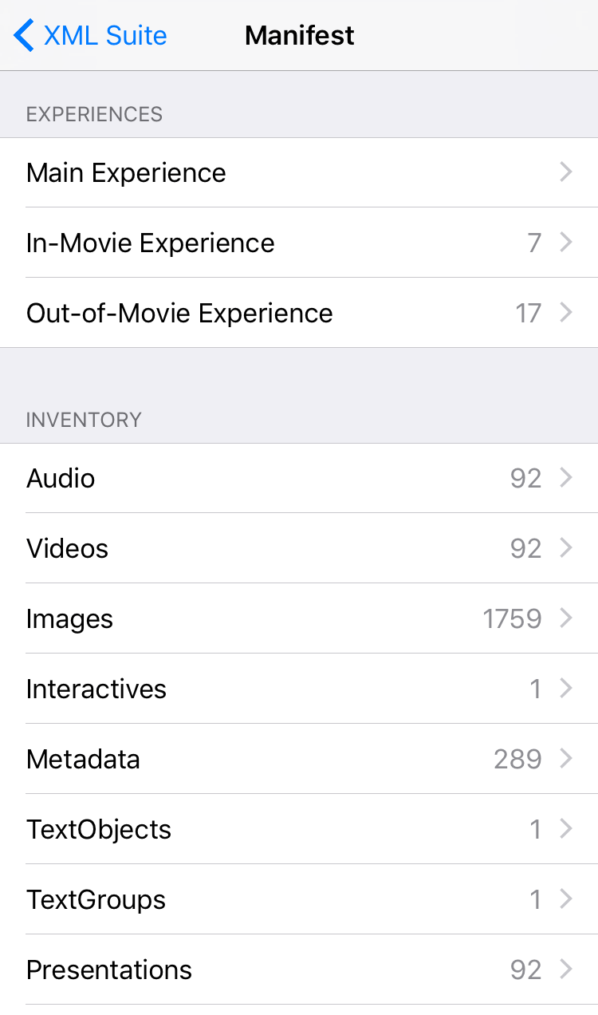
Solutions: Retailer Adoption
Published to CocoaPods dependency manager
pod ‘CPEExperience’
GitHub repositories contain robust sample projects
Documentation on user interaction callbacks and DRM solution integration
Easily load any remote XML files to test inventory parsing or launch a preview (i.e. “emulation”) of the full experience

